Slide 1
Circular Flow in a Two-sector Economy (with Financial Market)

Slide 2
Circular Flow in a Two-sector Economy (with Financial Market)
In the circular flow of an economy in a two-sector model without the financial market, it is assumed that no savings are made in the economy. It means that the households spend their entire income on the purchase of goods and services and every firm spends all the receipts from the sale of goods and services to make factor payments.

Slide 3
Circular Flow in a Two-sector Economy (with Financial Market)
However, it does not happen in the actual world, i.e., households do not spend their entire income on the consumption of goods and services. Instead, they save a part of their income for the future. In the same way, the firms save some part of their receipts for the expansion of business or various other reasons. Besides, the firms also borrow money from outside to finance their expansion plans. All of these savings and borrowings happening in the economy are channelised through the financial market. Therefore, in a two-sector economy, the savings made by households accumulated in the financial market are used by the firms for investment purposes.

Slide 4
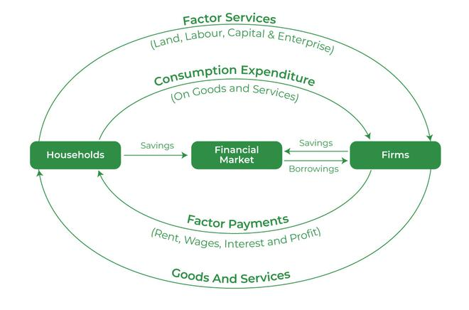
This concept can be better understood with the help of the following diagram:

